Slide 1
Nucleus Accumbens
An Introductory Guide

Slide 2
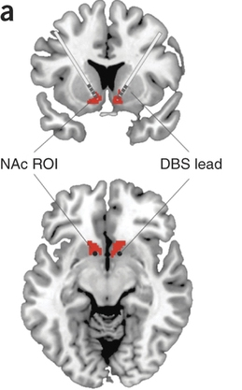
Location of the NAc
Adjacent to the Septum
Latin for: nucleus adjacent
to the septum
Ventral to the Striatum
called ventral striatum
Anterior to Preoptic
Hypothalamus (POA)
Posterior to vmPFC

Slide 3
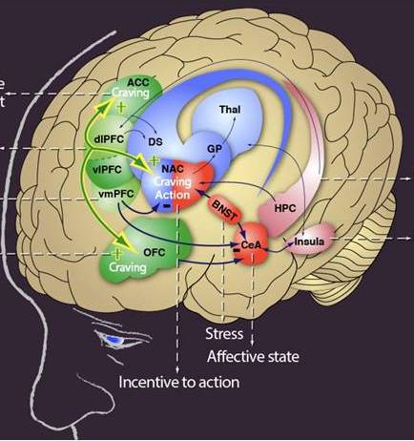
NAc – relative location

Slide 4
NAc – Ventral Striatum
where head of the caudate
+ anterior putamen meet
nucleus accumbens
ventral olfactory tubercle
ventral caudate
Ventral putamen
collectively form
the ventral striatum

Slide 5
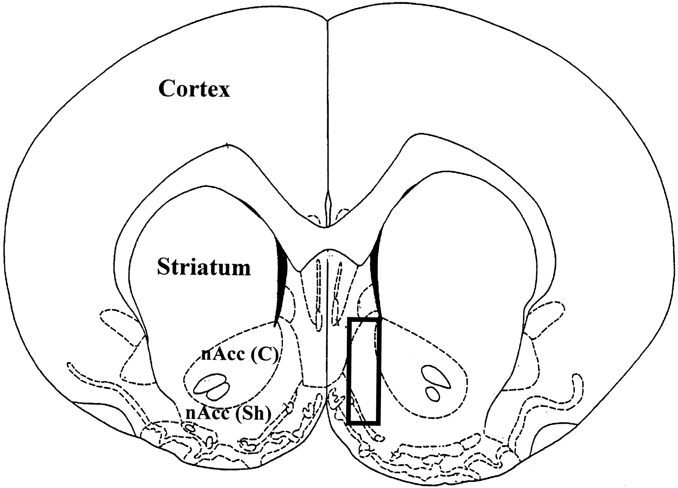
Heterogeneous Anatomical Organization
medial Shell
More lateral Core
Surrounds the anterior commissure

Slide 6
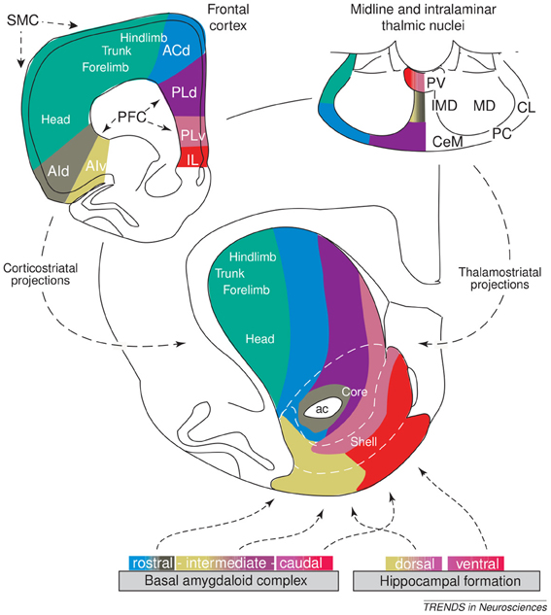
Heterogeneous Organization
Collection of Neuronal Ensembles
Differential connectivity of Core & Shell
Inputs from Temporal and Frontal Lobes
Distinct Topographical Organization

Slide 7
NAc Circuit Organization - Motivation-related inputs
Dopamine (DA) from the VTA to NAc
Ventral Tegmental Area …and Substantia Nigra
Phasic release
Stimulated by ACh from the pedunculopontine and laterodorsal tegmenta = PPT & LDT
Stimulated by Glu from the Cortex
Inhibited by GABA from NAc & Striatum
Tonic release
Mesolimbic Pathway (DA and Glu)
Brain Derived Neurotrophic Factor (BDNF)
Same Neurons

Slide 8
NAc Circuit Organization - Internal NAc and NAc outputs
DA release onto Medium Spiny Neurons
MSNs are GABAergic (> 95%)
Projection neurons to Striatum, VTA
Interneurons within the Nac
Mostly GABAergic
< 1% ACh
Express D₁ and D₂ receptors
D₁ are stimulatory: G_{s} → ↑ AC → ↑ cAMP → ↑ PKA
→ ↑ GABA output from MSNs
D₂ are inhibitory: G_{i} →X AC → cAMP
→ ↓ GABA output from MSNs

Slide 9
NAc Circuit Organization - NAc outputs
Direct Pathway
MSNs expressing D₁ receptors
Projecting to basal ganglia output nuclei
Dorsal Striatum (caudate, putamen, globus pallidus), Substantia Nigra
VAThalamus, Motor Cortex (M₁)/Limbic/PFC
Disinhibitory Pathway:
↑ GABA output from MSNs inhibit
GABA inhibitory projections from VAThalamus
To M₁ – influencing motivation and movement

Slide 10
NAc Circuit Organization - NAc outputs
Indirect Pathway
MSNs expressing D₂ receptors
Projecting to basal ganglia output nuclei
Dorsal Striatum (caudate, putamen, globus pallidus), SN, VLThalamus, M₁/Limbic/PFC
Inhibitory Pathway: ↓ GABA output from MSNs
↑ GABA output from VL Thalamus
Parallel Pathways are modulated
By D₁ and D₂ MSNs
to facilitate movement and motivation

Slide 11
NAc Circuit Organization - Cortical Pyramidal Projections
Cortex → Glutamate (Glu) → NAc
Fast acting
VTA also sends Glu projections to NAc
Intra-Cortical connections
Recurrent Activity
Process Cognitive, Memory, and Affective Information

Slide 12
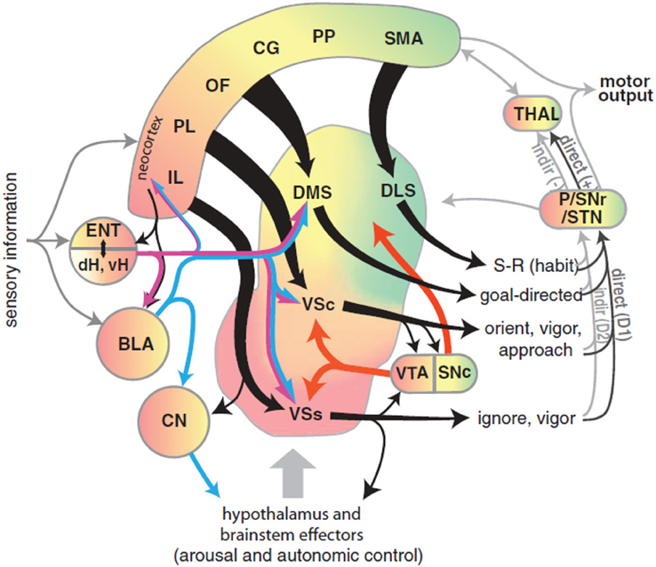
Cortico-Limbic Accumbal Projections

Slide 13
NAc Circuit Organization - Limbic Pyramidal Projections
BLA → Glutamate (Glu) → NAc
Basolateral amygdala
Processing prediction of appetitive or aversive consequences
Processing Affective Salience
Hippocampus → Glu → NAc
Process Cognitive, Memory, and Affective Information

Slide 14
Core and Shell
Lateral Shell
More substance P (SP), calretinin, DA, 5-HT
More 5-HT receptors
Rich in neurotensin, cholecystokinin (CCK), and opioids
Similar to striatum, features analogous to extended amygdala
Efferents to LH, afferents from BLA
Medial Core
More Calbindin, enkephalin, and GABA_{A}

Slide 15
Reward
1° or Conditioned Rewards stimulate
DA Burst Firing
Spatially restricted
Rapid (< 1s) Phasic Signaling
Magnitude encodes availability or receipt
Large vs Small rewards
Non-reward stimuli or Omission
Brief
Phasic Suppression
In DA neural firing

Slide 16
Continuous Rate of Reward
Presynaptic excitatory inputs to NAc
Stimulate relatively slow (minutes)
Tonic change to DA levels
Covering a broad population of NAC neurons
Modulate incoming presynaptic signals
Therefore modulate the actions of
D₁, D₂, and D₃ receptors
Provides an integrated, continuous estimate of the net rate of reward

Slide 17
Not Reward?
Lesions / Inactivation of the NAc
Does NOT reduce consumption of 1° rewards
Food
Suppression of NAc Shell neural activity → ↑Feeding
↓NAc DA does NOT reduce
Hedonic reactions to palatable tastes
NAc function is neither Necessary nor Sufficient for instrumental reward learning
For 1° rewards or conditioned reinforcement

Slide 18
Not Reward?
Lesions of the NAc subregions
Does NOT impair learning self-administration
Of Psychostimulant drugs
Disruption of NAc function
Doesn’t impair behaviors for procuring rewards
Is the NAc a Reward Center?
Oversimplification of NAc function?
Exaggerates NAc function?

Slide 19
Invigoration of Behavior
NAc - an essential role in enabling stimuli
Associated with Reward
1° function of mesoaccumbens DA
Modulate Glu inputs on NAc neuronal firing
To Invigorate Behavior
Bias Approach
↑ or ↓ NAc DA/Glu activity ↑ or ↓ locomotor activity
DA cannot drive rapid NAc signaling
In the same manner as Glu presynaptic inputs

Slide 20
Gating and Integrating
Differential Actions of DA
Especially the modulation of cognitive and emotional inputs to the NAc
Make it ideally suited for Gating
And Integrating inputs to the NAc
Amplifying information of some inputs
Via D₁ receptors
Concurrently attenuating other inputs
Via D₂ receptors

Slide 21
Aversion and Avoidance
NAc role in aversive fear responses
NAc Core lesions/DA depletion
Impair acquisition or expression
of conditioned avoidance
Phasic ↑ DA signals impending punishment
Early cues → ↓ DA release in NAc Core
Once an avoidance response is learned
Warning cue trigger → ↑ DA release
NAc – Helps get closer to good things &
Away from bad things

Slide 22
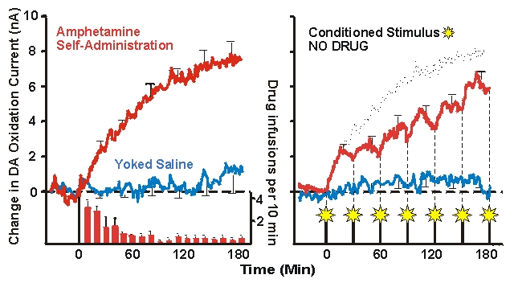
Response to Stress
Stress or corticosterone

Slide 23
Approach
Inactivation of NAc
Disconnecting Hippocampal input to NAc
Disrupts search accuracy
Only in complex or ambiguous conditions
Obstacles, Distractors, Uncertainty
NAc does not mediate all types of approach
Toward rewards, safety, or associated stimuli
Biasing the Direction of Behavior
Biasing the Intensity of Behavior

Slide 24
NAc Core - Approach
NAc Core instigates Approach
Toward stimuli associated with rewards
And stimuli associated with safety
NAc Core lesions
NAc DA receptor antagonists
Disconnecting Anterior Cingulate from NAc Core
Reduces approach toward incentive stimuli

Slide 25
BLA → NAc Core - Approach
Information from the Basolateral Amygdala
Necessary to facilitate timely Approach
Required for efficient Approach
Reward cues →↑ BLA neuron firing
Followed by →↑ NAc Core neuron firing
Inactivation of BLA →↓ Approach
→↓ NAc firing in response to reward cues
∴BLA, NAc, DA necessary for Approach

Slide 26
NAc Shell – suppression of alternate behavior
Nac Shell gating behavioral expression
Appetitive vs Consummatory Behaviors
Anterior NAc Shell gates feeding
Posterior NAc Shell gates defensive behavior
Inactivation of NAc Shell
Increases responses NOT toward Reward
Necessary for finding New Rewards?
Alternate Rewards?
Necessary for finding Safety?

Slide 27
NAc Shell – suppression of alternate behavior
Disconnecting NAc Shell
Causes entrance of maze elements equally
Regardless of reward pairing
Does reward uncertainty functionally remove the salience of reward pairing?
Inactivation of NAc Shell
Reduced preference for larger,
But less certain
Rewards

Slide 28
What is the NAc?
Integrates Memory and Emotional Signals
Integrated with information from the BLA, Hippocampus, PFC…
Helps determine Response Priorities
Integrates Cognitive and Emotional Signals
Turns them into Action
Via output to Basal Ganglia and Motor Effector Sites
Modifies Future Action
Via output to Cortical and Limbic Regions
Via modification of preference and priorities

